Slide 1
CSE 4109: Artificial Intelligence
M.M.A. Hashem, PhD
Professor,
Dept. of Computer Science and Engineering
Khulna University of Engineering & Technology (KUET)
Khulna 9203, Bangladesh
Email; hashem@cse.kuet.ac.bd
Cell Phone: +880 1714 003949

Slide 2
Bayesian Networks
More commonly called graphical models
A way to depict conditional independence relationships between random variables
A compact specification of full joint distributions

Slide 3
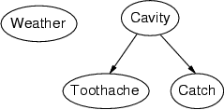
Structure
Nodes: random variables
Can be assigned (observed) or unassigned (unobserved)
Arcs: interactions
An arrow from one variable to another indicates direct influence
Encode conditional independence
Weather is independent of the other variables
Toothache and Catch are conditionally independent given Cavity
Must form a directed, acyclic graph

Slide 4
Example: N independent coin flips
Complete independence: no interactions
…
X₁
X₂
X_{n}

Slide 5
Example: Naïve Bayes spam filter
Random variables:
C: message class (spam or not spam)
W₁, …, W_{n}: words comprising the message
C
…
W₁
W₂
W_{n}

Slide 6
Example: Burglar Alarm
I have a burglar alarm that is sometimes set off by minor earthquakes. My two neighbors, John and Mary, promised to call me at work if they hear the alarm
Example inference task: suppose Mary calls and John doesn’t call. What is the probability of a burglary?
What are the random variables?
Burglary, Earthquake, Alarm, JohnCalls, MaryCalls
What are the direct influence relationships?
A burglar can set the alarm off
An earthquake can set the alarm off
The alarm can cause Mary to call
The alarm can cause John to call

Slide 7
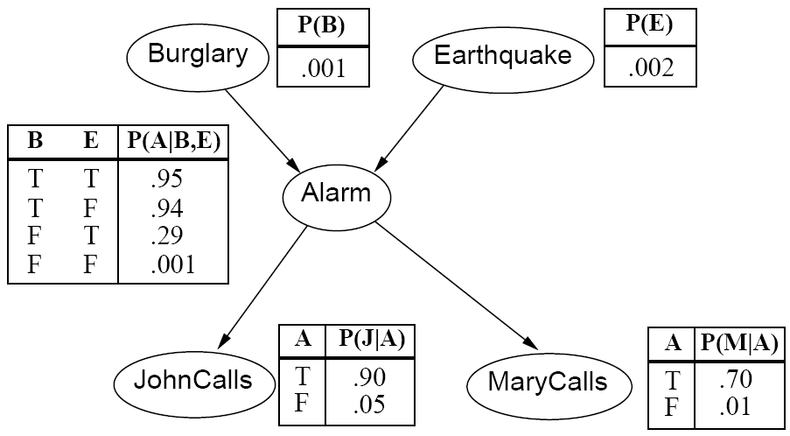
Example: Burglar Alarm
What are the model parameters?

Slide 8
Conditional probability distributions
To specify the full joint distribution, we need to specify a conditional distribution for each node given its parents: P (X | Parents(X))
…
Z₁
Z₂
Z_{n}
X
P (X | Z₁, …, Z_{n})

Slide 9
Example: Burglar Alarm

Slide 10
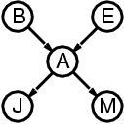
The joint probability distribution
For each node X_{i}, we know P(X_{i} | Parents(X_{i}))
How do we get the full joint distribution P(X₁, …, X_{n})?
Using chain rule:
For example, P(j, m, a, ¬b, ¬e)
= P(¬b) P(¬e) P(a | ¬b, ¬e) P(j | a) P(m | a)

Slide 11
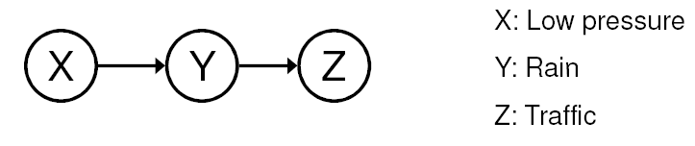
Conditional independence
Key assumption: X is conditionally independent of every non-descendant node given its parents
Example: causal chain
Are X and Z independent?
Is Z independent of X given Y?

Slide 12
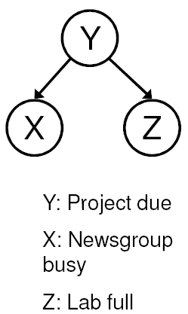
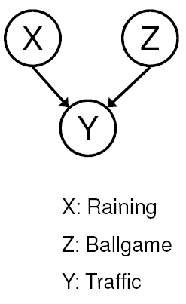
Conditional independence
Common cause
Are X and Z independent?
No
Are they conditionally independent given Y?
Yes
Common effect
Are X and Z independent?
Yes
Are they conditionally independent given Y?
No

Slide 13
Compactness
Suppose we have a Boolean variable X_{i} with k Boolean parents. How many rows does its conditional probability table have?
2^{k} rows for all the combinations of parent values
Each row requires one number p for X_{i} = true
If each variable has no more than k parents, how many numbers does the complete network require?
O(n · 2^{k}) numbers – vs. O(2^{n}) for the full joint distribution
How many nodes for the burglary network?
1 + 1 + 4 + 2 + 2 = 10 numbers (vs. 2⁵-1 = 31)

Slide 14
Constructing Bayesian networks
Choose an ordering of variables X₁, … , X_{n}
For i = 1 to n
add X_{i} to the network
select parents from X₁, … ,X_{i-1} such that P(X_{i} | Parents(X_{i})) = P(X_{i} | X₁, ... X_{i-1})

Slide 15
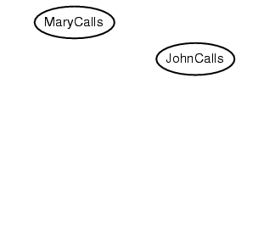
Example
Suppose we choose the ordering M, J, A, B, E
P(J | M) = P(J)?

Slide 16
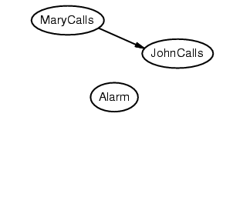
Example
Suppose we choose the ordering M, J, A, B, E
P(J | M) = P(J)? No

Slide 17
Example
Suppose we choose the ordering M, J, A, B, E
P(J | M) = P(J)? No
P(A | J, M) = P(A)?
P(A | J, M) = P(A | J)?
P(A | J, M) = P(A | M)?

Slide 18
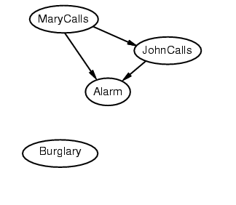
Example
Suppose we choose the ordering M, J, A, B, E
P(J | M) = P(J)? No
P(A | J, M) = P(A)? No
P(A | J, M) = P(A | J)? No
P(A | J, M) = P(A | M)? No

Slide 19
Example
Suppose we choose the ordering M, J, A, B, E
P(J | M) = P(J)? No
P(A | J, M) = P(A)? No
P(A | J, M) = P(A | J)? No
P(A | J, M) = P(A | M)? No
P(B | A, J, M) = P(B)?
P(B | A, J, M) = P(B | A)?

Slide 20
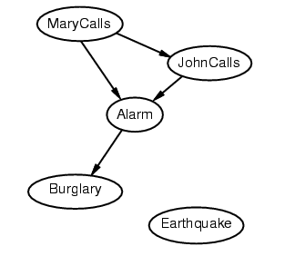
Example
Suppose we choose the ordering M, J, A, B, E
P(J | M) = P(J)? No
P(A | J, M) = P(A)? No
P(A | J, M) = P(A | J)? No
P(A | J, M) = P(A | M)? No
P(B | A, J, M) = P(B)? No
P(B | A, J, M) = P(B | A)? Yes

Slide 21
Example
Suppose we choose the ordering M, J, A, B, E
P(J | M) = P(J)? No
P(A | J, M) = P(A)? No
P(A | J, M) = P(A | J)? No
P(A | J, M) = P(A | M)? No
P(B | A, J, M) = P(B)? No
P(B | A, J, M) = P(B | A)? Yes
P(E | B, A ,J, M) = P(E)?
P(E | B, A, J, M) = P(E | A, B)?

Slide 22
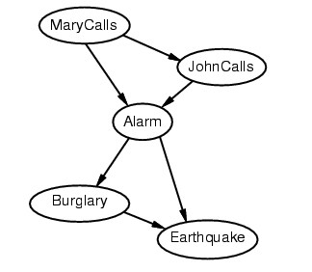
Example
Suppose we choose the ordering M, J, A, B, E
P(J | M) = P(J)? No
P(A | J, M) = P(A)? No
P(A | J, M) = P(A | J)? No
P(A | J, M) = P(A | M)? No
P(B | A, J, M) = P(B)? No
P(B | A, J, M) = P(B | A)? Yes
P(E | B, A ,J, M) = P(E)? No
P(E | B, A, J, M) = P(E | A, B)? Yes

Slide 23
Example contd.
Deciding conditional independence is hard in noncausal directions
The causal direction seems much more natural
Network is less compact: 1 + 2 + 4 + 2 + 4 = 13 numbers needed

Slide 24
Example
Suppose we want to use the diagnostic assistant to diagnose whether there is a fire in a building based on noisy sensor information and possibly conflicting explanations of what could be going on. The agent receives a report about whether everyone is leaving the building. Suppose the report sensor is noisy: It sometimes reports leaving when there is no exodus (a false positive), and it sometimes does not report when everyone is leaving (a false negative). Suppose the fire alarm going off can cause the leaving, but this is not a deterministic relationship. Either tampering or fire could affect the alarm. Fire also causes smoke to rise from the building.

Slide 25
Suppose we use the following variables, all of which are Boolean, in the following order:
Tampering is true when there is tampering with the alarm.
Fire is true when there is a fire.
Alarm is true when the alarm sounds.
Smoke is true when there is smoke.
Leaving is true if there are many people leaving the building at once.
Report is true if there is a report given by someone of people leaving. Report is false if there is no report of leaving.

Slide 26
The variable Report denotes the sensor report that people are leaving. This information is unreliable because the person issuing such a report could be playing a practical joke, or no one who could have given such a report may have been paying attention. This variable is introduced to allow conditioning on unreliable sensor data. The agent knows what the sensor reports, but it only has unreliable evidence about people leaving the building.

Slide 27
As part of the domain, assume the following conditional independencies:
Fire is conditionally independent of Tampering (given no other information).
Alarm depends on both Fire and Tampering. That is, we are making no independence assumptions about how Alarm depends on its predecessors given this variable ordering.
Smoke depends only on Fire and is conditionally independent of Tampering and Alarm given whether there is a Fire.
Leaving only depends on Alarm and not directly on Fire or Tampering or Smoke. That is, Leaving is conditionally independent of the other variables given Alarm.
Report only directly depends on Leaving.

Slide 28
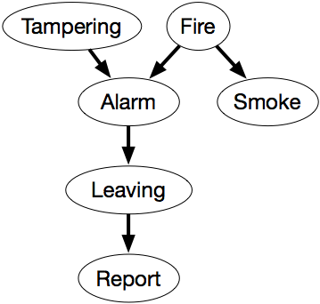
The following belief network expresses these dependencies.
This network represents the factorization
P(Tampering,Fire,Alarm,Smoke,Leaving,Report) =P(Tampering) ×P(Fire) ×P(Alarm|Tampering,Fire)
×P(Smoke|Fire) ×P(Leaving|Alarm) ×P(Report|Leaving).

Slide 29
We also must define the domain of each variable. Assume that the variables are Boolean; that is, they have domain {true,false}. We use the lower-case variant of the variable to represent the true value and use negation for the false value. Thus, for example, Tampering=true is written as tampering, and Tampering=false is written as ¬tampering.

Slide 30
The examples that follow assume the following conditional probabilities:
P(tampering) = 0.02 P(fire) = 0.01 P(alarm | fire ∧tampering) = 0.5 P(alarm | fire ∧¬tampering) = 0.99 P(alarm | ¬fire ∧tampering) = 0.85 P(alarm | ¬fire ∧¬tampering) = 0.0001 P(smoke | fire ) = 0.9 P(smoke | ¬fire ) = 0.01 P(leaving | alarm) = 0.88 P(leaving | ¬alarm ) = 0.001 P(report | leaving ) = 0.75 P(report | ¬leaving ) = 0.01

Slide 31
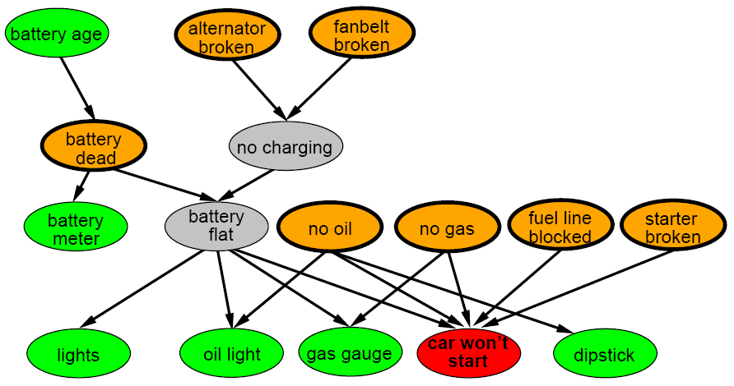
A more realistic Bayes Network: Car diagnosis
Initial observation: car won’t start
Orange: “broken, so fix it” nodes
Green: testable evidence
Gray: “hidden variables” to ensure sparse structure, reduce parameteres

Slide 32
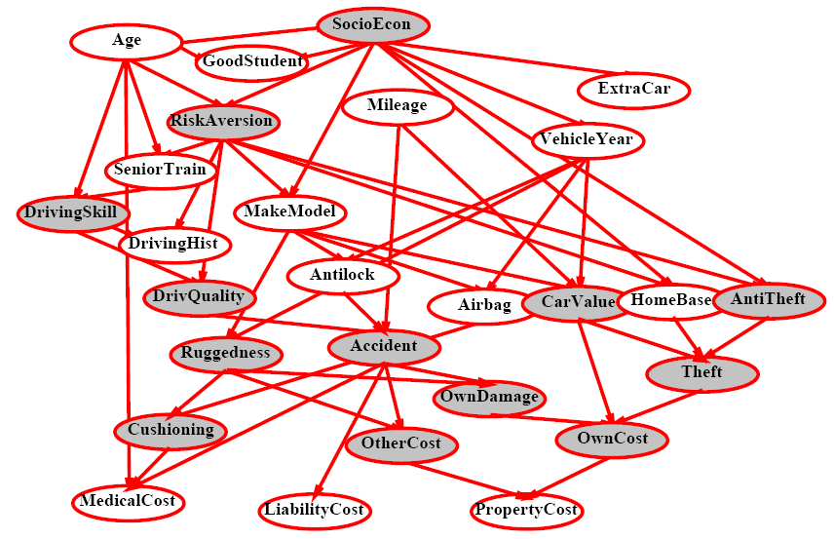
Car insurance

Slide 33
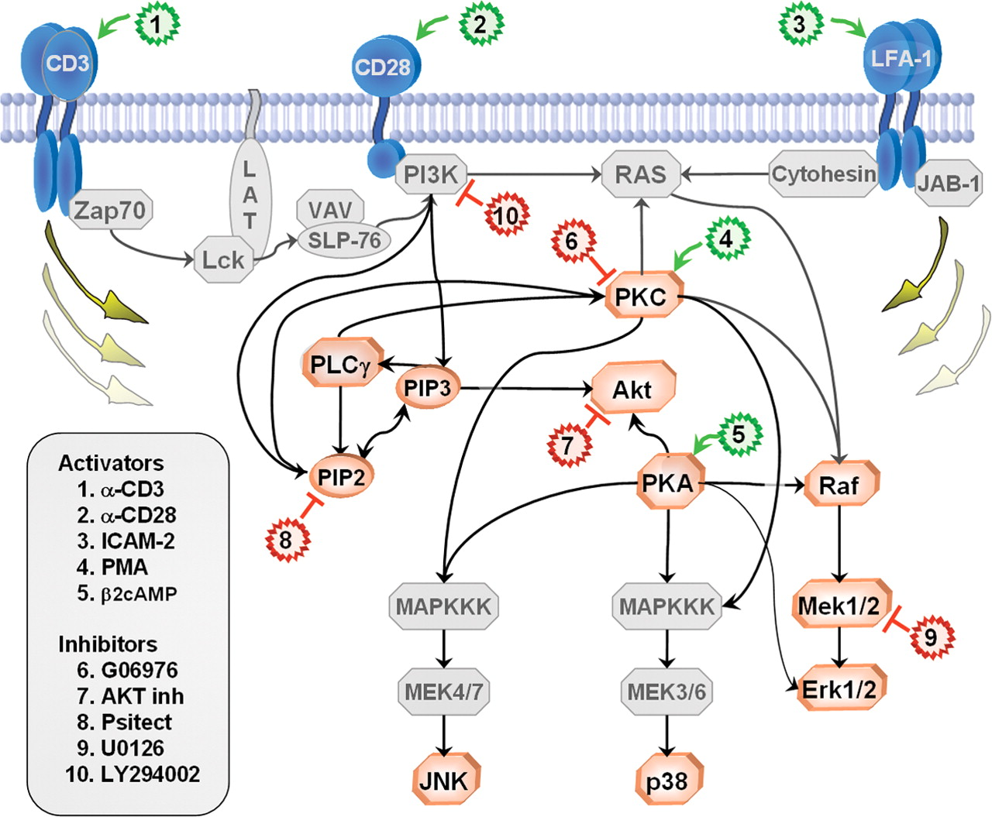
In research literature…
Causal Protein-Signaling Networks Derived from Multiparameter Single-Cell Data
Karen Sachs, Omar Perez, Dana Pe'er, Douglas A. Lauffenburger, and Garry P. Nolan
(22 April 2005) Science 308 (5721), 523.

Slide 34
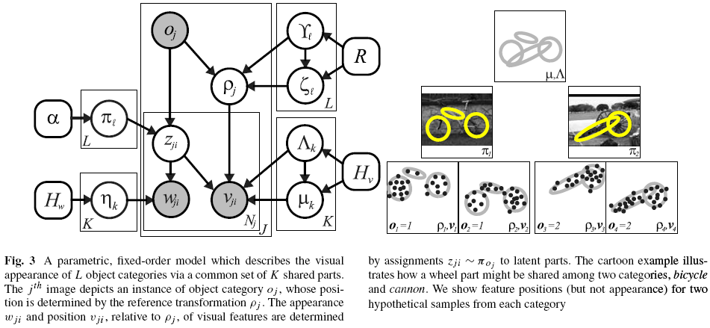
In research literature…
Describing Visual Scenes Using Transformed Objects and Parts
E. Sudderth, A. Torralba, W. T. Freeman, and A. Willsky.
International Journal of Computer Vision, No. 1-3, May 2008, pp. 291-330.

Slide 35
Summary
Bayesian networks provide a natural representation for (causally induced) conditional independence
Topology + conditional probability tables
Generally easy for domain experts to construct

Slide 36
Probabilistic inference
A general scenario:
Query variables: X
Evidence (observed) variables: E = e
Unobserved variables: Y
If we know the full joint distribution P(X, E, Y), how can we perform inference about X?
Problems
Full joint distributions are too large
Marginalizing out Y may involve too many summation terms

